Slide 1
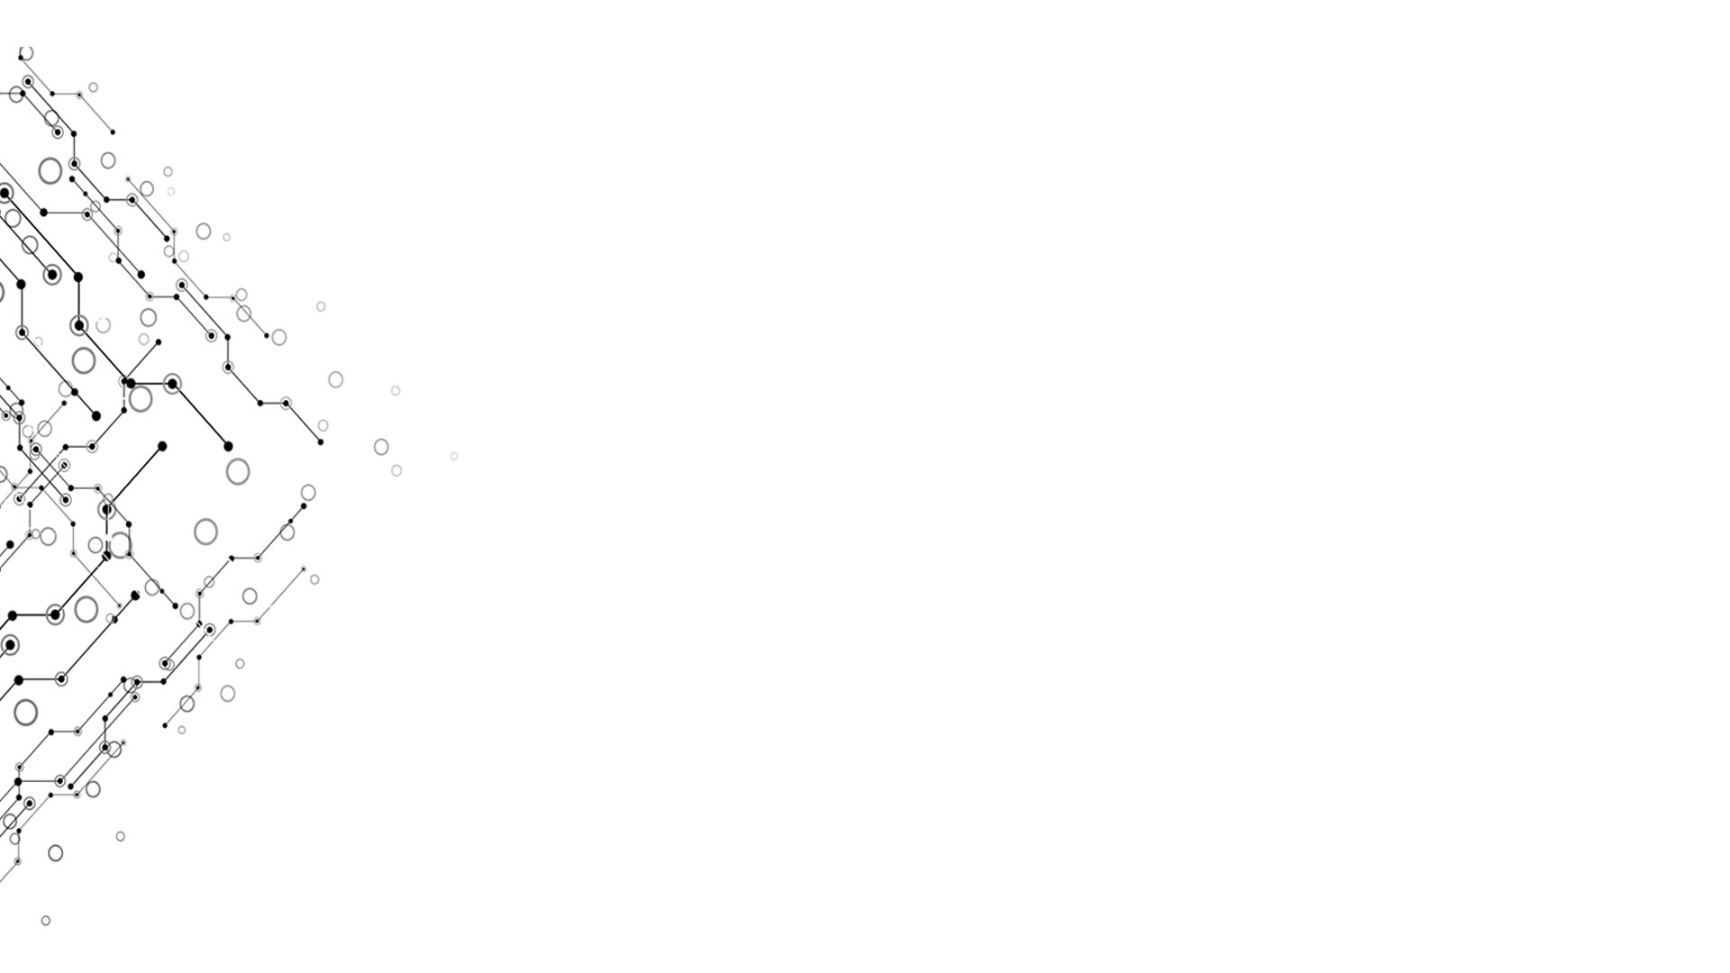

Assemble Language
Computational Thinking and System Design
Group 2
Week 4

Slide 2

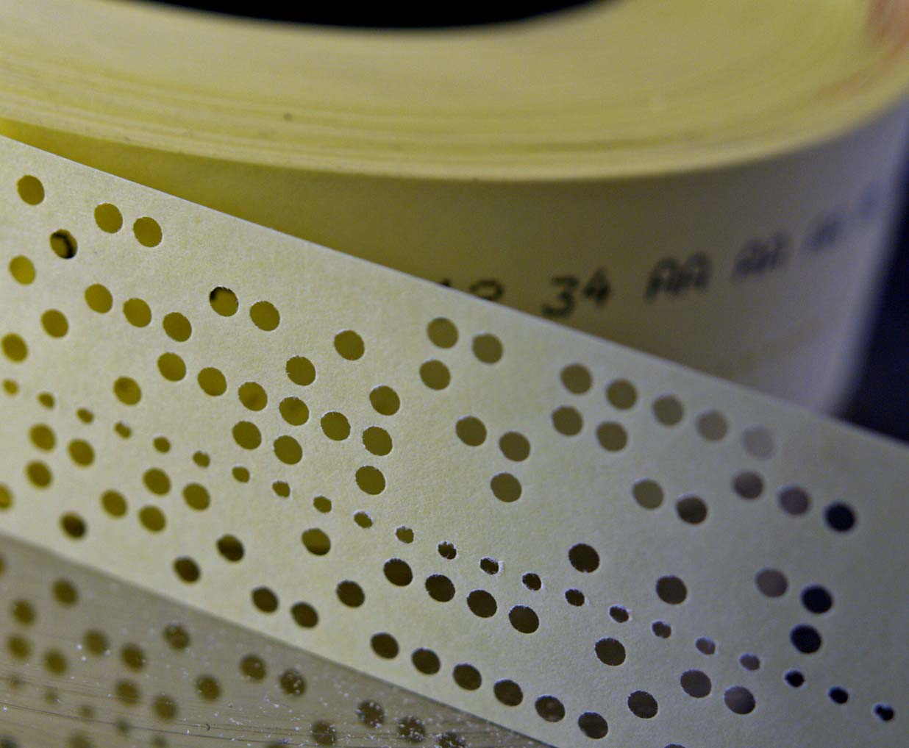

Instructions:
Just a sequence of bits
Move,load and save data:(D,A,M)
Compute: ALU
Control of flow: jump
Computational Thinking and System Design

Slide 3
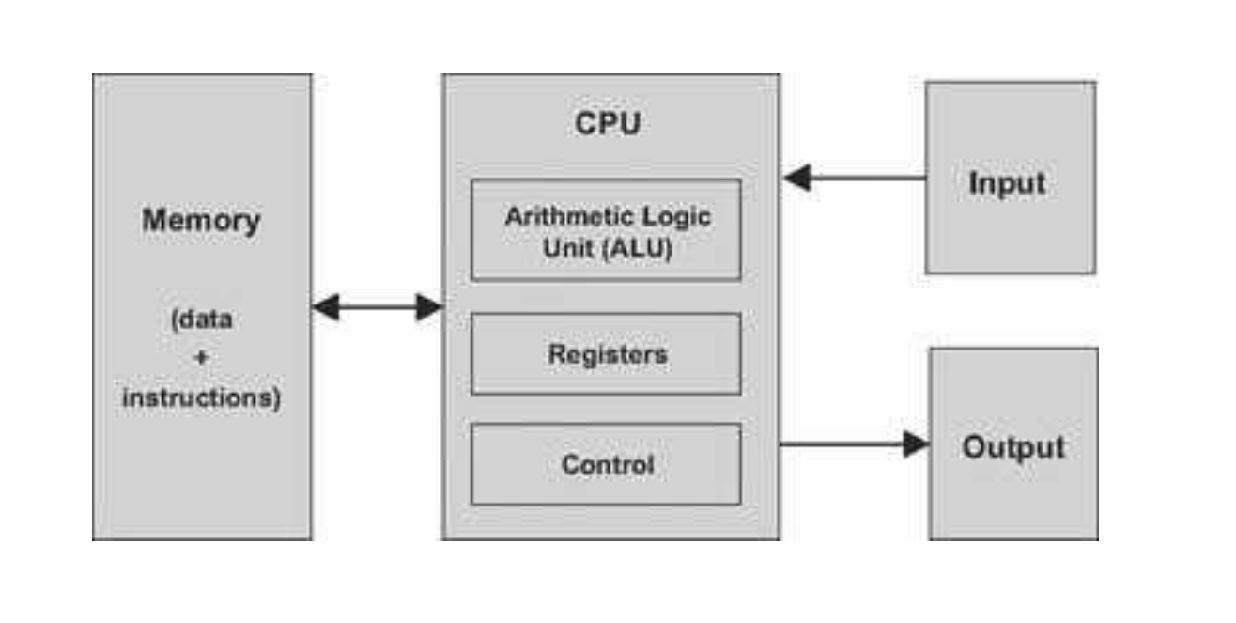
Computational Thinking and System Design

Slide 4
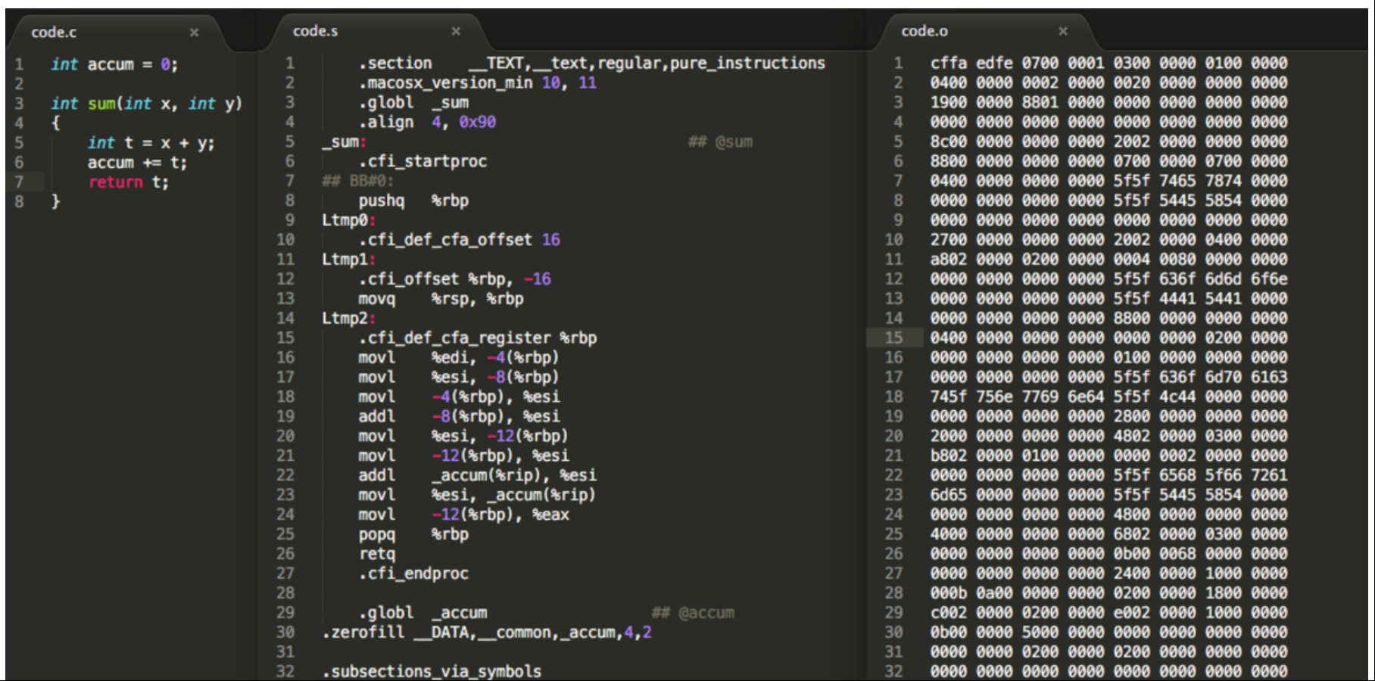
X86 (maybe)
Computational Thinking and System Design

Slide 5
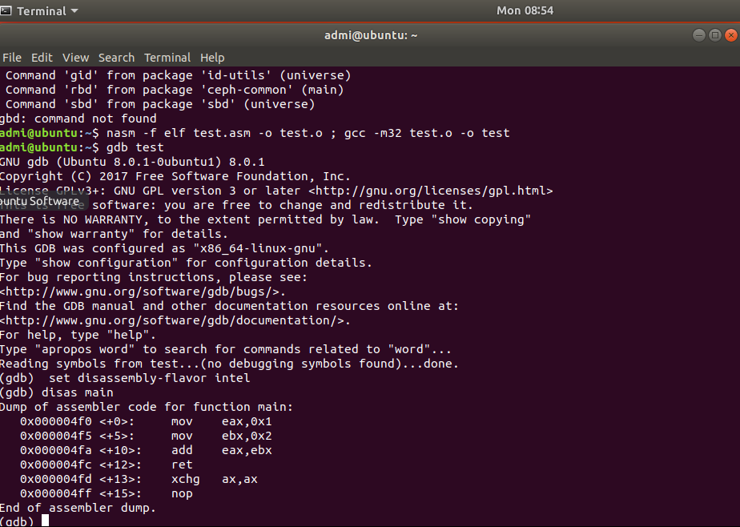
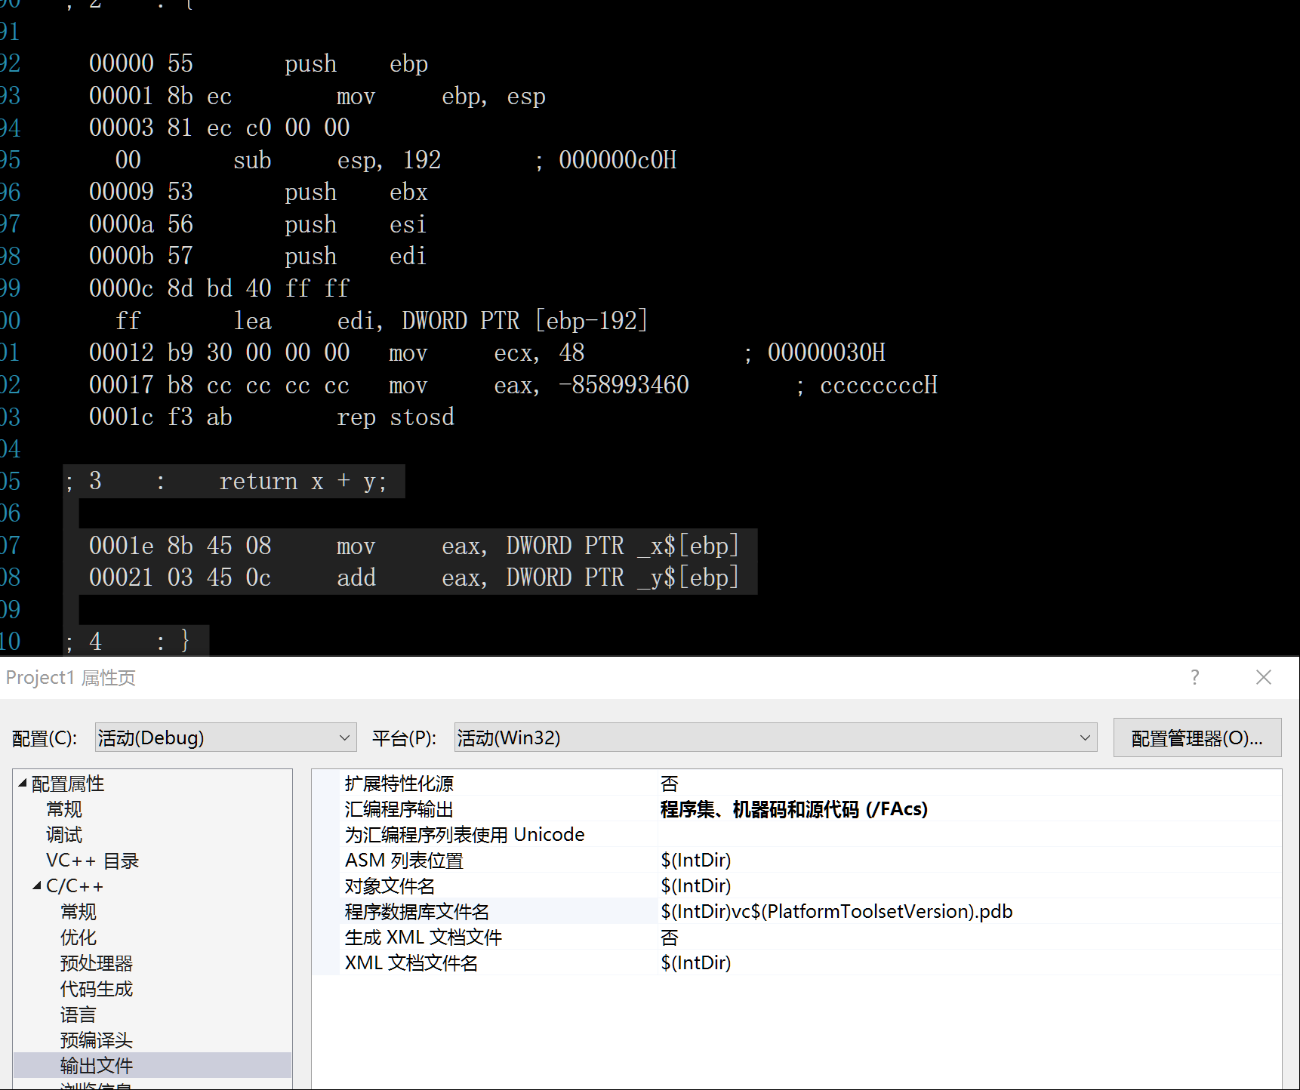
Computational Thinking and System Design

Slide 6
Function in assemble language
What to consider?
Record where we are
Get parameter in place
Return
Computational Thinking and System Design

Slide 7
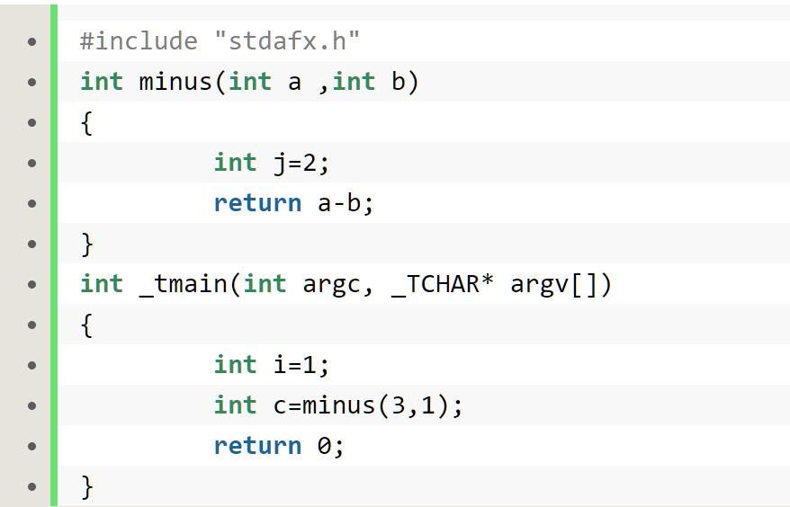
Function CALL in STACK
Push value in stack
Record the address of the next instruction in stack
Push ebp in stack ,set it to esp
Set space for local parameters
Function contents
Store the return value in eax, return, free the stack.
Computational Thinking and System Design

Slide 8
Thank you for your time!
Computational Thinking and System Design

